Slide 1
3. Intro Decision Trees

Slide 2
Decision Trees
Problem: decide whether to wait for a table at a restaurant, based on the following attributes:
Alternate: is there an alternative restaurant nearby?
Bar: is there a comfortable bar area to wait in?
Fri/Sat: is today Friday or Saturday?
Hungry: are we hungry?
Patrons: number of people in the restaurant (None, Some, Full)
Price: price range ($, $$, $$$)
Raining: is it raining outside?
Reservation: have we made a reservation?
Type: kind of restaurant (French, Italian, Thai, Burger)
WaitEstimate: estimated waiting time (0-10, 10-30, 30-60, >60)

Slide 3
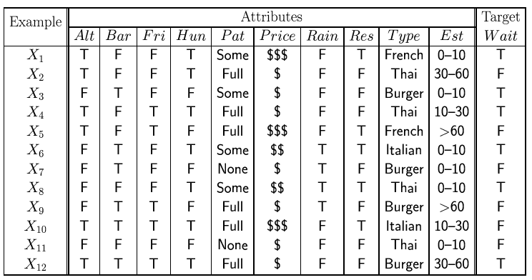
Attribute-based representations
Examples described by attribute values (Boolean, discrete, continuous)
E.g., situations where I will/won't wait for a table:
Classification of examples is positive (T) or negative (F)
General form for data: a number N of instances, each with attributes (x1,x2,x3,...xd) and target value y.

Slide 4
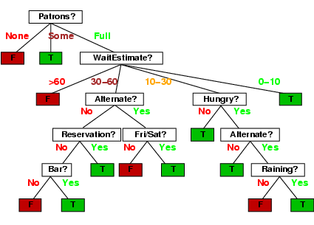
Decision trees
One possible representation for hypotheses
We imagine someone taking a sequence of decisions.
E.g., here is the “true” tree for deciding whether to wait:
Note you can use the same
attribute more than once.

Slide 5
Decision tree learning
If there are so many possible trees, can we actually search this space? (solution: greedy search).
Aim: find a small tree consistent with the training examples
Idea: (recursively) choose "most significant" attribute as root of (sub)tree.

Slide 6
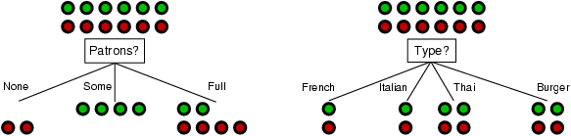
Choosing an attribute
Idea: a good attribute splits the examples into subsets that are (ideally) "all positive" or "all negative"
Patrons or type?
To wait or not to wait is still at 50%.

Slide 7
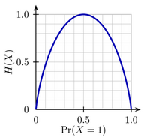
Using information theory
Entropy measures the amount of uncertainty
in a probability distribution:
Consider tossing a biased coin.
If you toss the coin VERY often,
the frequency of heads is, say, p,
and hence the frequency of tails is
1-p. (fair coin p=0.5).
The uncertainty in any actual outcome
is given by the entropy:
Note, the uncertainty is zero if p=0 or 1
and maximal if we have p=0.5.

Slide 8
Using information theory
Imagine we have p examples which are true (positive) and n examples which are false (negative).
Our best estimate of true or false is given by:
Hence the entropy is given by:

Slide 9
Using Information Theory
How much information do we gain if we disclose the value of some attribute?
Answer:
uncertainty before minus uncertainty after

Slide 10
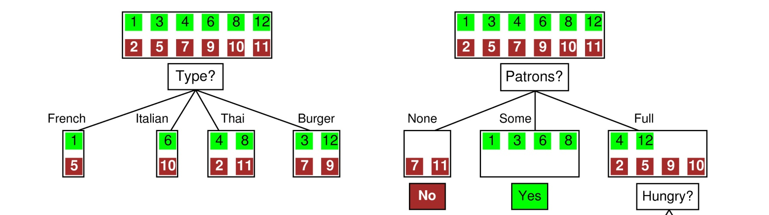
Example
Before: Entropy = - ½ log(1/2) – ½ log(1/2)=log(2) = 1 bit:
There is “1 bit of information to be discovered”.
After: for Type: If we go into branch “French” we have 1 bit, similarly for the others.
French: 1bit
Italian: 1 bit
Thai: 1 bit
Burger: 1bit
After: for Patrons: In branch “None” and “Some” entropy = 0!,
In “Full” entropy = -1/3log(1/3)-2/3log(2/3).
So Patrons gains more information!
On average: 1 bit ! We gained nothing!

Slide 11
Information gain
Information Gain (IG) or reduction in entropy from the attribute test:
Choose the attribute with the largest IG

Slide 12
Information gain
For the training set, p = n = 6, I(6/12, 6/12) = 1 bit
Patrons has the highest IG of all attributes and so is chosen by the DTL algorithm as the root
Is it sensible to have the same attribute on a single branch of the tree (why)?

Slide 13
Continuous Variables
If variables are continuous we can bin them, or..
We can learn a simple classifier on a single dimension
E.g. we can find a decision point which classifies all data to the left of that point in one class and all data to the right in the other
We can also use a small subset of dimensions and train a linear classifier (e.g. logistic regression classifier).

Slide 14
Overfitting and Underfitting
Overfitting:
Given a model space H, a specific model h∈H is said to overfit the training data if there exists some alternative model h’∈H, such that h has smaller error than h’ over the training examples, but h’ has smaller error than h over the entire distribution of instances
Underfitting:
The model is too simple, so that both training and test errors are large

Slide 15
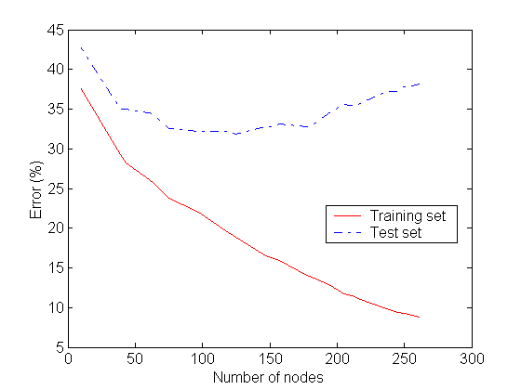
Detecting Overfitting
Overfitting

Slide 16
Overfitting in Decision Tree Learning
Overfitting results in decision trees that are more complex than necessary
Tree growth went too far
Number of instances gets smaller as we build the tree (e.g., several leaves match a single example)
Training error no longer provides a good estimate of how well the tree will perform on previously unseen records

Slide 17
Avoiding Tree Overfitting – Solution 1
Pre-Pruning (Early Stopping Rule)
Stop the algorithm before it becomes a fully-grown tree
Typical stopping conditions for a node:
Stop if all instances belong to the same class
Stop if all the attribute values are the same
More restrictive conditions:
Stop if number of instances is less than some user-specified threshold
Stop if expanding the current node does not improve impurity measures (e.g., GAIN)

Slide 18
Decision Tree Based Classification
Advantages:
Inexpensive to construct
Extremely fast at classifying unknown records
Easy to interpret for small-sized trees
Disadvantages:
Redundancy
Need to retrain with new data

